Slide 1
Trends in udemy
As analysed in python

Slide 2
Goal
To check how time has affected udemy.
To see the changes in trends.
To see the relationship with various attributes that are in udemy and also in the given dataset.
To see how job trends have affected the number of subscribers.

Slide 3
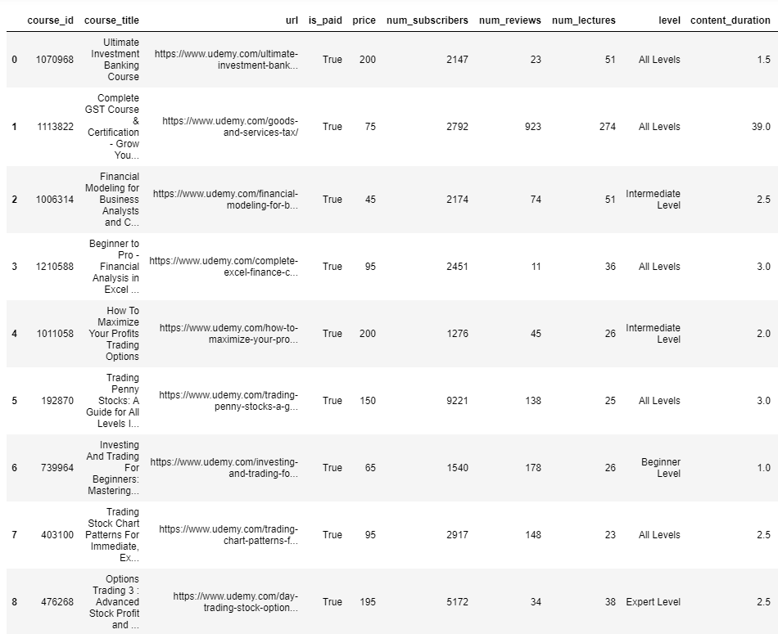
A small peak into the data

Slide 4
The data was pretty clean!
So I checked the correlation between the attributes
And found some intresting thing

Slide 5
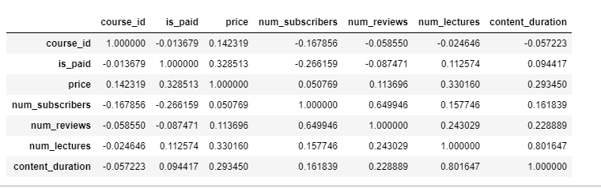
This lead me into making some intresting comparisons

Slide 6
Ill just put the cmparisons out
And then give my insights

Slide 7
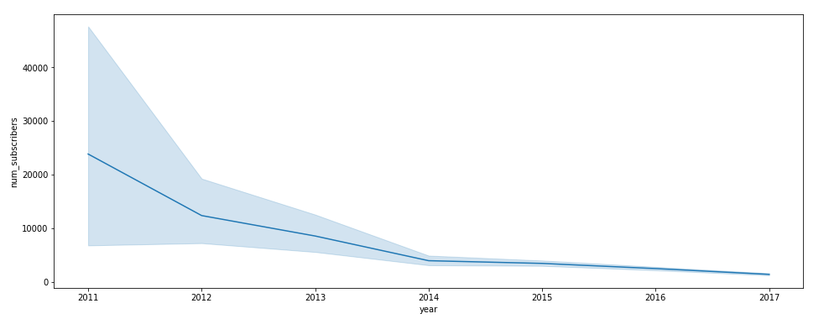
How subscribers have been over the year

Slide 8
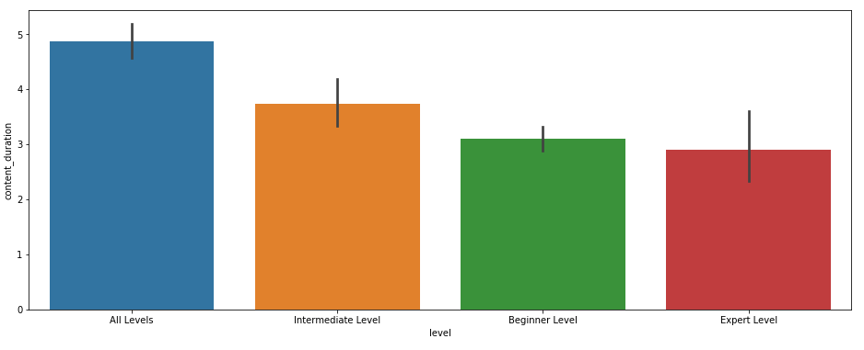
Content duration vs level of knowledge needed

Slide 9
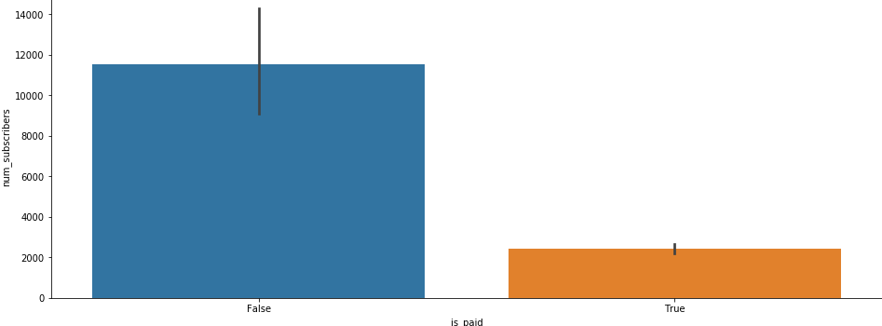
Is having paid courses good?

Slide 10
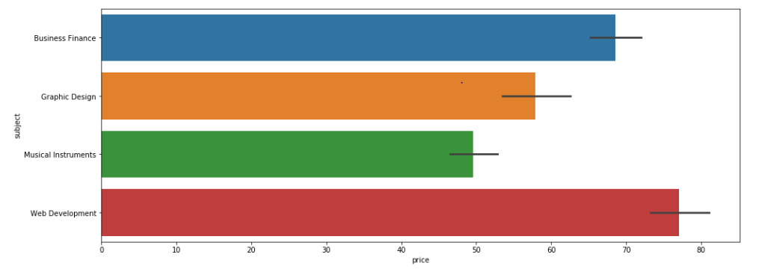
Subjects vs price

Slide 11
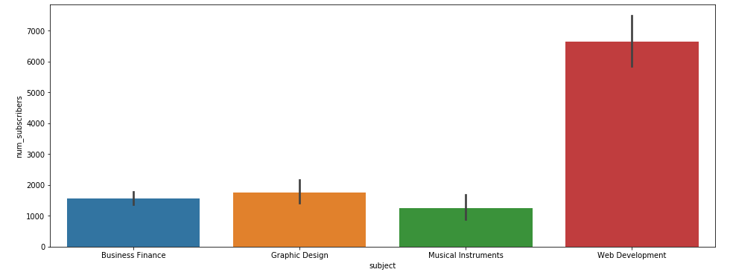
Which subject has the most subsribers

Slide 12
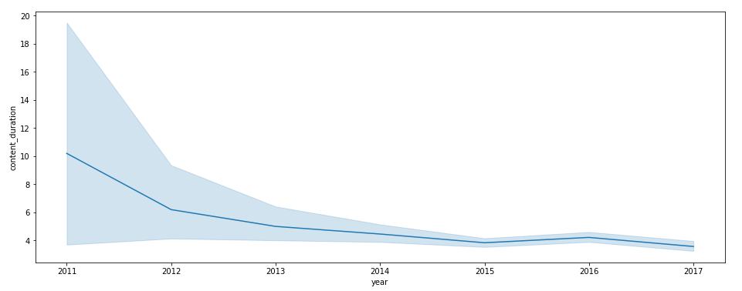
Years vs content_duration

Slide 13
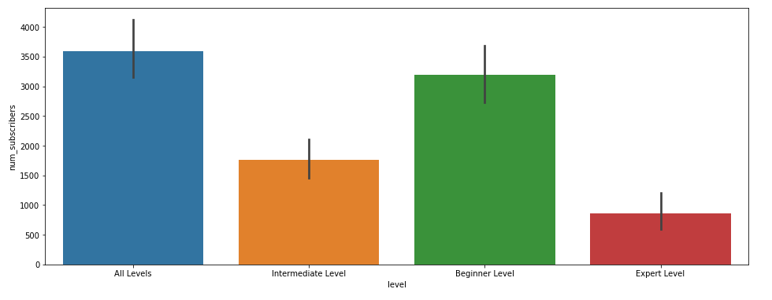
Level vs subscribers

Slide 14
Some insights that can be drawn
Udemy is an amazing platform which offers people with high quality courses at a fraction of their original prices. The model is straight forward you pay for a course with a refund policy and have lifetime access.
So udemy is very smart in their pricing they increase their prices depending on the demand of the stream as we can see the rise in the cost of web development as the demand for fullstack engineers increase
The amount of courses in udemy is insanely high, interestingly the content duration is decreasing steadily

Slide 15
Continued..
There are a surprising amount of free courses in udemy which may have a lot of subscribers but the content is unreliable the amount as the number of subscribers to review is less.. As we progress we realise that udemy is highly dependent on the current trends we get to see new courses and discounts depending on the current trends.
And something that’s slightly intresting is the courses which are meant for all levels have the most subscribers
So some idea that can be taken is that in order to be successful in udemy is to have a decent training background and having a team is also a plus and with crisp videos and well structured foreign forum and with an ability to explain the trending topics in high school level standards
Could make you very very successful some even have a million subscribers

Slide 16
furthermore
All in all to conclude udemy is an amazing place to make good revenue but you’ll need to maintain the ability to explain things in a crisp and clear manner and be ready to help with enthusiasm..
You’ll go far

Slide 17
Thank you!
Vikramaditya
-noob

